Slide 1

Global Electricity Consumption
Seth Harris, Joaquin Ramirez, Leonel Salazar, Collin Real
DA 6233.902 – Data Analytics Visualization & Communication
Fall 2023

Slide 2
Overview
Introduction
Global Consumption Over Time
Highest Energy Consumers
Distribution Losses
Imports/Exports
Conclusion

Slide 3
INTRODUCTION
Energy is the ultimate form of currency
Energy consumption is an economic indicator
Current dependence on scarce resources
Climate change policies
Key stakeholders

Slide 4
Population Growth
Economic Growth
Rising Living Standards
Urbanization
Energy-Intensive Industries
Transportation demands
Inefficient Energy Practices
Global Consumption

Slide 5
Energy Consumption by Region

Slide 6
Energy Consumption by Country
China
United States

Slide 7
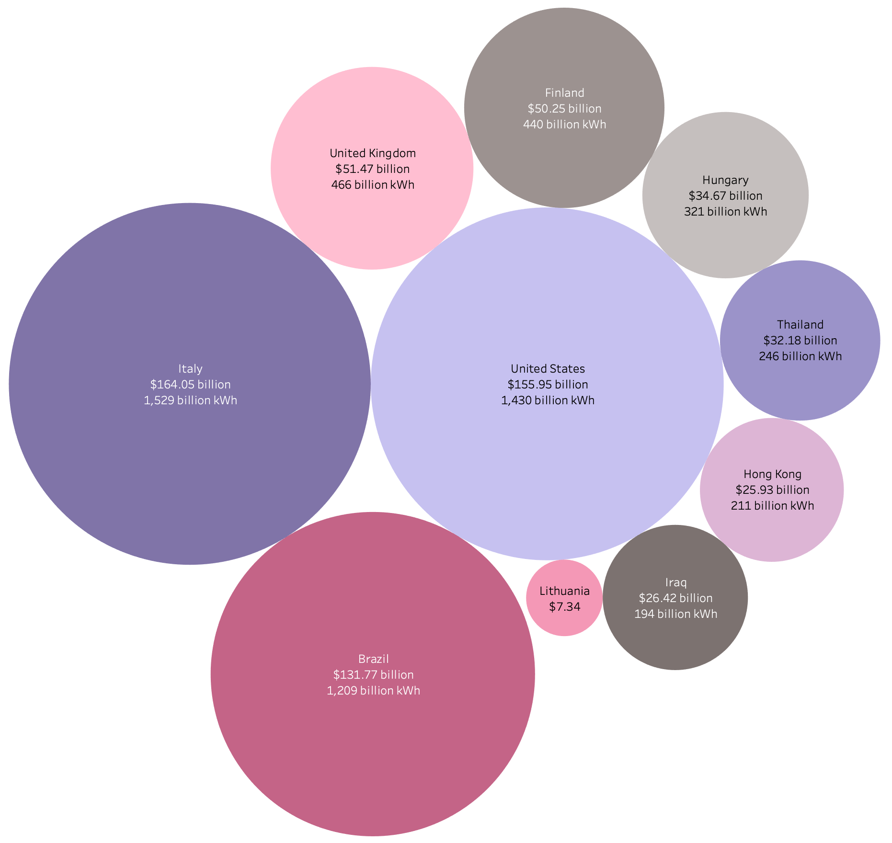
Net Imports

Slide 8
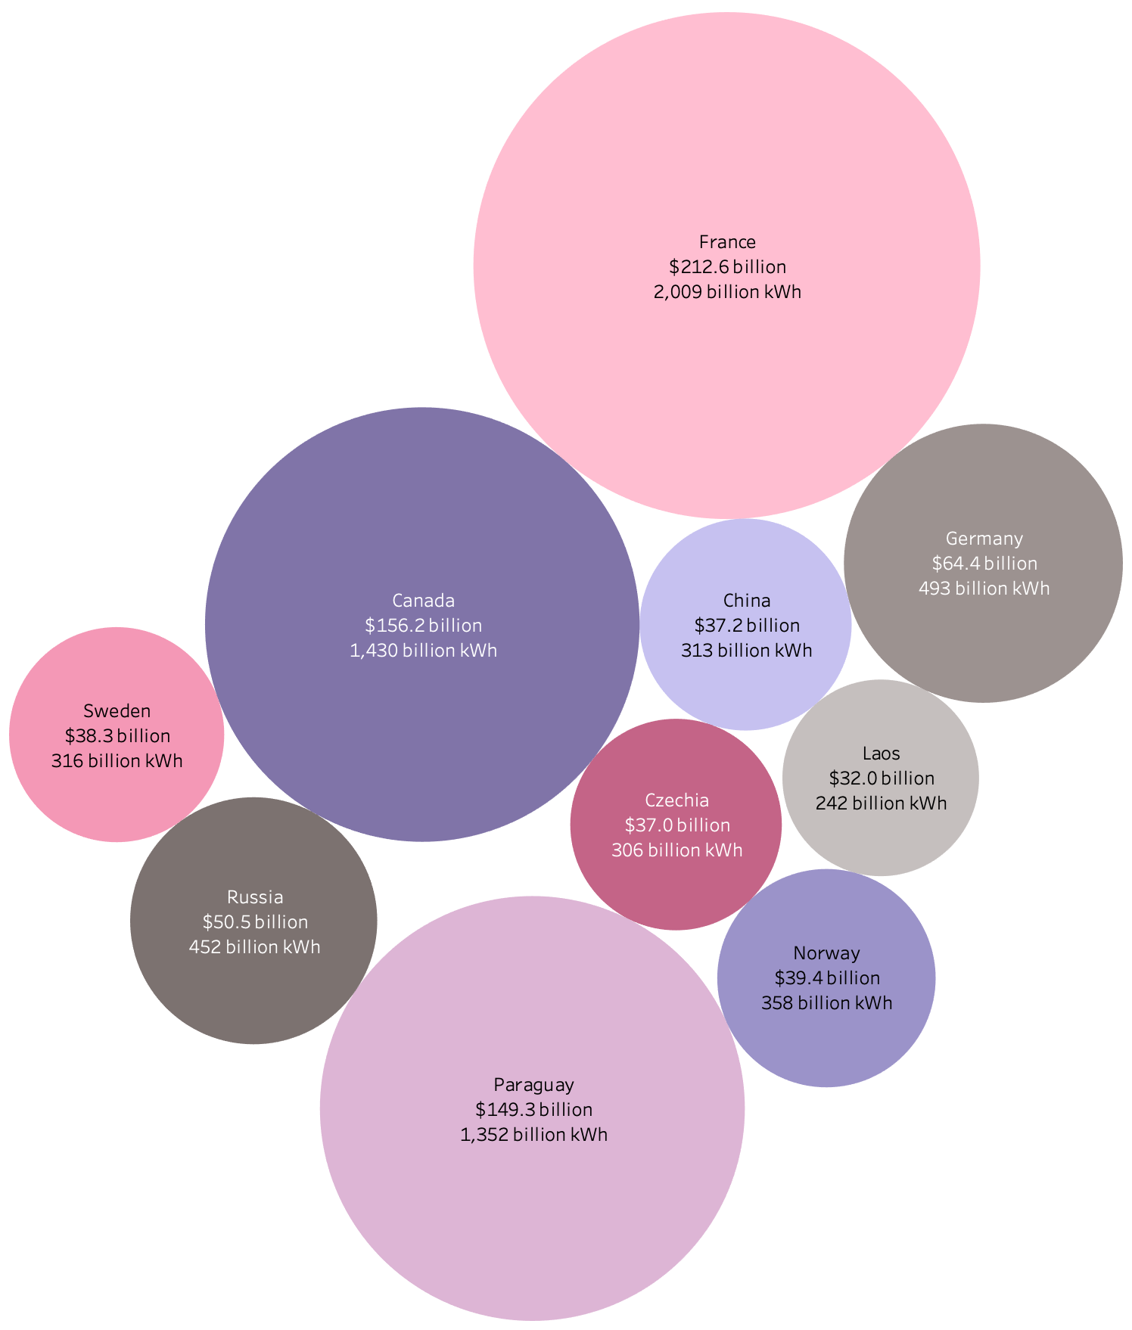
Net Exports

Slide 9
Distribution Losses

Slide 10
Conclusion
Our exploration of global energy consumption has revealed not just China's rise but also the complex interplay of population growth, economic forces, and societal changes, resulting in a fourfold increase since 1980.
The implications for our environment and global development are profound, emphasizing the critical need for a sustainable approach to energy consumption.
China's ascent in energy consumption isn't just a statistical feat; it's a narrative of economic dynamism and global influence.
Reflecting on this transformative shift, we must consider the future implications for global energy dynamics and the geopolitical landscape, recognizing China's undeniably significant role in shaping the world's energy future

